Slide 1
Fundamentals of Object-Orient Program
Week-04
Fall - 2025
Subject: Software Construction & Development
Instructor: Mr. Sharif Hussain

Slide 2
Contents
Fundamentals of Object-Oriented Program
Object collaboration and association
UML (Unified Modeling Language)
UML Class Diagrams

Slide 3
Object-Oriented Programming (OOP)
Object-Oriented Programming (OOP) is a programming paradigm that provides a standard approach to designing and developing software using classes and objects.

Slide 4
Importance and Advantages of OOP
OOP is important because it makes software more organized, reusable, secure, and closer to real-life systems, leading to faster development and easier maintenance.

Slide 5
Object-Oriented Concepts using Java
Java is based on Object-Oriented Programming (OOP), which means it uses real-world ideas to make programs easy to understand and manage.
  Class
  Object
  Construction
  Abstraction
  Encapsulation
  Inheritance
  Polymorphism

Slide 6
Class and Object
Class
  A class is like a blueprint or plan or template .
  It defines what an object will look like and what it can do.
  Example: A class named Car defines features like colour, speed, and functions like start() or stop().
Object
  An object is a real example of a class.
  It is created from a class and has actual data.
  👉 Example:
    Car myCar = new Car();
    Car yourCar = new Car();

Slide 7
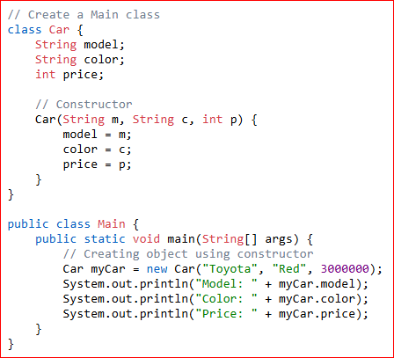

Class and Object

Slide 8
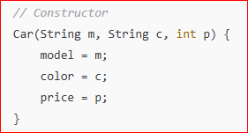
Constructor
A constructor is a special method used to create and initialize objects.
It sets the initial values of the object’s data.
Example: When you create a car object, the constructor sets its model, color, and price.

Slide 9
Abstraction
Abstraction means showing only the important details and hiding the complex parts.
  Example: When you drive a car, you just press the accelerator — you don’t need to know how the engine works.

Slide 10
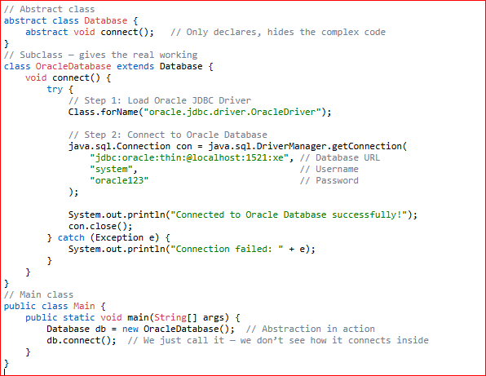
Abstraction (Cont.)

Slide 11
Encapsulation
Encapsulation is the process of binding data and methods that operate on that data within a single unit (class) and restricting direct access to the data to ensure security and controlled modification.

Slide 12
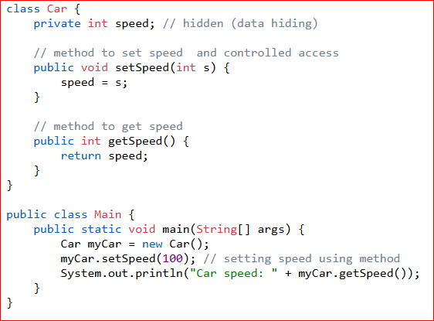
Encapsulation (cont.)

Slide 13
Encapsulation (cont.)
Encapsulation
  private int speed; → hides the data (data hiding).
  setSpeed() → gives controlled access (you change speed only through this method).
  getSpeed() → gives safe access to read the data.

Slide 14
Inheritance
Inheritance means one class (child) can get or use the properties and methods of another class (parent).
It helps us reuse code instead of writing it again.
  Example: A class SportsCar can inherit from the class Car, so it already has all the features of Car.

Slide 15
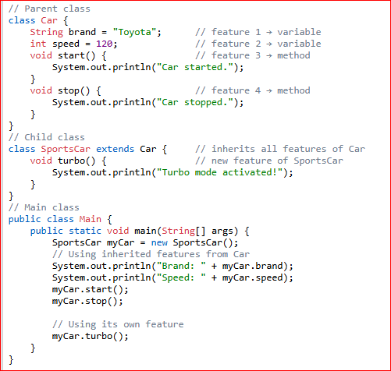
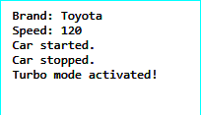
Inheritance (Cont.)

Slide 16
Polymorphism
Polymorphism means one thing can behave in different ways.
  Example: The method start() may work differently for a Car and a Bike, even though both use the same name.

Slide 17
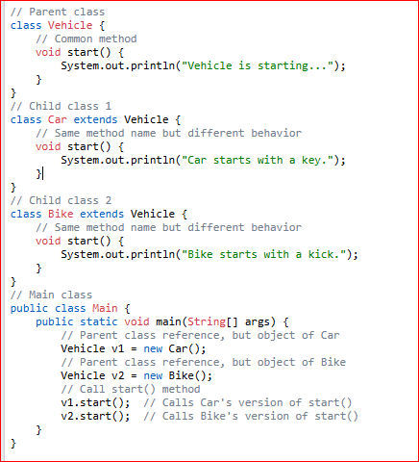
Polymorphism (Cont.)

Slide 18
Object Association and Collaboration
Object Association:
  Association describes a relationship between two classes where objects of one class are connected to objects of another class.
  Key point: It shows “uses” or “knows about” relationship.
Object Collaboration
  Collaboration happens when objects of different classes work together to perform a task.
  Key point: Collaboration is about works together, not just a static relationship.
  Example: A Car object collaborates with Engine and FuelSystem objects to start the car.

Slide 19
Object Association and Collaboration
Object Association:
Association describes a relationship between two classes, where objects of one class are connected to objects of another class.
Key point: It shows a “uses” or “knows about” relationship.
Object Collaboration:
Collaboration occurs when objects of different classes work together to perform a task.
Key point: Collaboration is about working together, not just a static relationship.
Example: A Car object collaborates with Engine and FuelSystem objects to start the car.

Slide 20
Object Association
Types of Association:
  One-to-One: One object of a class is associated with one object of another class.
    Example: A Person has one Passport.
  One-to-Many: One object of a class is associated with many objects of another class.
  Example: A Teacher teaches many Students.
  Many-to-Many: Many objects of a class are associated with many objects of another class.
    Example: Students enroll in many Courses, and each Course has many Students.

Slide 21
Object Association
Types of Association:
  One-to-One: One object of a class is associated with one object of another class.
    Example: A Person has one Passport.
  One-to-Many: One object of a class is associated with many objects of another class.
  Example: A Teacher teaches many Students.
  Many-to-Many: Many objects of a class are associated with many objects of another class.
    Example: Students enroll in many Courses, and each Course has many Students.

Slide 22
Unified Modeling Language(UML)
Unified Modeling Language (UML) is a standard visual modeling language used to design and represent the structure and behavior of a system.
Similar to engineering blueprints.
UML is not a programming language but a visual tool that aids software engineers, architects, and analysts in modeling, design, and analysis.

Slide 23
Why Use Unified Modeling Language?
UML diagrams are often used in software development. They are helpful for two main reasons when designing new products or systems.

Slide 24
Types of UML Diagrams
Structural Diagrams ➔ what it is” (classes, objects, components)
  Class Diagram
  Object Diagram
  Component Diagram
  Package Diagram
  Deployment Diagram

Slide 25
Types of UML Diagrams
Behavioral Diagrams ➔ what it does (interactions, actions, processes)
  Use Case Diagram
  Sequence Diagram
  Activity Diagram
  State Diagram
  Communication Diagram

Slide 26
Thanks
...?

